Slide 1

Vrinda Store Annual Report 2022

Slide 2
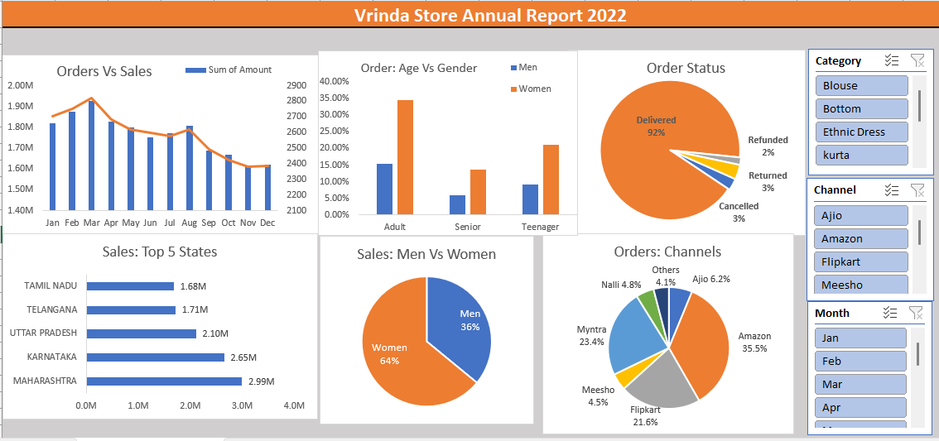

Slide 3
Sample Insights
Women are more likely to buy compared to men (~65%)
Maharashtra, Karnataka and Uttar Pradesh are the top 3 states (~35%)
Adult age group (30-49 yrs) is max contributing (~50%)
Amazon, Flipkart and Myntra channels are max contributing (~80%)
Final Conclusion to improve Vrinda store sales:
Target women customers of age group (30-49 yrs) living in Maharashtra, Karnataka and Uttar Pradesh by showing ads/offers/coupons available on Amazon, Flipkart and Myntra

